Slide 1
DEEPIOTICS PRESENTS
Your Store Never Closes.
Your Profit Never Sleeps.
A complete online store, built for you — run it yourself, or let us run it for you.
2026
DEEPIOTICS · WEB SOLUTIONS · 2026
CONFIDENTIAL

Slide 2




THE REALITY
Behind every business is an owner
who built something worth buying.
…but online, most of them are invisible.
Customers can't find you
People search online before they buy. If your store isn't there, they buy from someone who is.
We build your web solution —
one that takes your business
to customers worldwide.
Every change needs a developer
Updating a price or a product photo means calling someone, waiting days, and paying again.
Marketplaces eat your profit
THE DEEPIOTICS STANDARD
Selling only through big platforms means a commission taken from every single sale.
DEEPIOTICS · WEB SOLUTIONS · 2026
CONFIDENTIAL

Slide 3
THE PROBLEM AT SCALE
Shoppers have moved online. Most stores haven't kept up.
75%
53%
70%
57%
of shoppers judge whether to trust a business by its website design
of mobile shoppers leave if a page takes over 3 seconds to load
of online shopping carts are abandoned — usually due to a clumsy checkout
of shoppers won't recommend a business with a poor mobile site
Source: Stanford Web Credibility Research
Source: Google
Source: Baymard Institute
Source: SuperMonitoring
Independent research: Stanford University, Google mobile-speed research, Baymard Institute checkout studies, and SuperMonitoring mobile UX data.
DEEPIOTICS · WEB SOLUTIONS · 2026
CONFIDENTIAL

Slide 4





HIDDEN COSTS
What selling without your own store really costs you.
Waiting on developers
Invisible on Google
Clumsy on mobile
Every small change is billable, slow, and completely out of your hands.
If you're not on the first page, competitors quietly take your customers.
Most people shop on their phone. If checkout feels hard, they simply quit.
Commission on every sale
No one watching the site
Everything stays manual
Marketplaces take their cut first. Your margin shrinks with every order.
An unwatched store slows down, breaks, and becomes a security risk.
No payments, delivery, or order tracking connected — so selling stays hard work.
DEEPIOTICS · WEB SOLUTIONS · 2026
CONFIDENTIAL

Slide 5


THE GAP
What agencies deliver vs. what your store actually needs.
WHAT MOST AGENCIES DELIVER
WHAT YOUR BUSINESS ACTUALLY NEEDS
A template with your logo dropped in
A store designed around your products and brand
Launch, invoice, disappear
A partner who stays — or a true handover
An SEO plugin installed — never set up
Built so Google shows you to real shoppers
No training, no documentation
Training, simple guides, and real ownership
A new quote for every small change
Predictable costs you can plan around
DEEPIOTICS · WEB SOLUTIONS · 2026
CONFIDENTIAL

Slide 6

A BETTER WAY
The old way vs. the Deepiotics way.
THE OLD WAY
THE DEEPIOTICS WAY
A generic template store
Custom-built and fully on-brand
No control over your own store
Simple panel — edit anything, anytime
One-time handoff, then silence
A partner who stays as you grow
Hoping shoppers somehow find you
Built to rank on Google from day one
Manual orders and payments
Payments, delivery & tracking built in
DEEPIOTICS · WEB SOLUTIONS · 2026
CONFIDENTIAL

Slide 7



OUR TWO SERVICE MODELS
Run it yourself — or let us run it. You choose.
MODEL 1
MODEL 2
Self-Managed (CMS)
Yearly Maintenance Plan
Complete online store, custom built
Everything in the Self-Managed model
Update photos, prices & descriptions yourself
Every update handled by our team
Add products & categories in minutes
Security checks & speed monitoring
Training session + simple how-to guide
Monthly reports — sales, visitors, health
You own everything — store, code & content
Priority support with guaranteed response
30-day post-launch support included
New features added as your store grows
Best for teams that want full day-to-day control.
Best for owners who want it handled — completely.
Hosting, CDN & payment gateway charges billed monthly, separately.
DEEPIOTICS · WEB SOLUTIONS · 2026
CONFIDENTIAL

Slide 8




HOW WE WORK
A simple process — no jargon, no drama, no delays.
01
02
03
04
Understand Your Business
Design & Build
Launch & Training
Grow
We learn your products, your customers, and your goals — then plan the perfect store.
We design your store, add your products, and connect payments and delivery — mobile-first.
Your store goes live. We train your team on the panel — or start your maintenance plan.
We keep improving speed, Google ranking, and sales as your business scales.
DEEPIOTICS · WEB SOLUTIONS · 2026
CONFIDENTIAL

Slide 9






WHAT'S INCLUDED
Every store ships with the essentials — no upsell required.
Custom store design
Mobile-first build
Easy control panel
Found on Google
Designed around your brand and products — never a template.
Fast and smooth on the phones your customers actually shop with.
Update photos, prices, descriptions & categories yourself.
Built so shoppers searching for your products find you first.
Payments & checkout
Your own server
Global-ready
Sales dashboard
Secure payment options your customers already know and trust.
Dedicated hosting power — fast, reliable, and all yours.
Photos and videos load fast in every country, every language.
See visits, orders, and best-sellers at a glance.
DEEPIOTICS · WEB SOLUTIONS · 2026
CONFIDENTIAL

Slide 10



WORKS FOR EVERY INDUSTRY
One solution. Any business. Anywhere in the world.
Products
Services
Global Sellers
Fashion, food, decor, electronics
Hotels, salons, clinics, coaches
Any country, any currency
Product pages built to sell
Booking & appointment flows
Multiple languages supported
Categories & filters shoppers love
Packages & pricing pages
Fast loading worldwide
Offers, coupons & festival sales
Reviews & customer trust
Taxes & local rules handled
DEEPIOTICS · WEB SOLUTIONS · 2026
CONFIDENTIAL

Slide 11
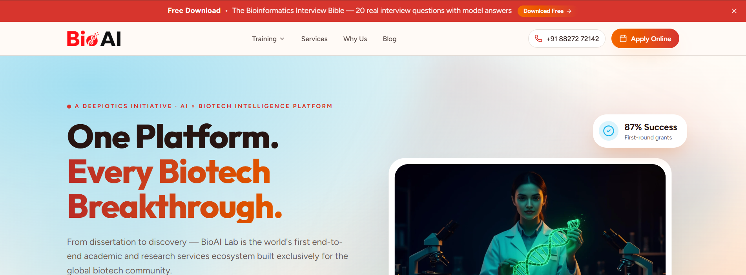
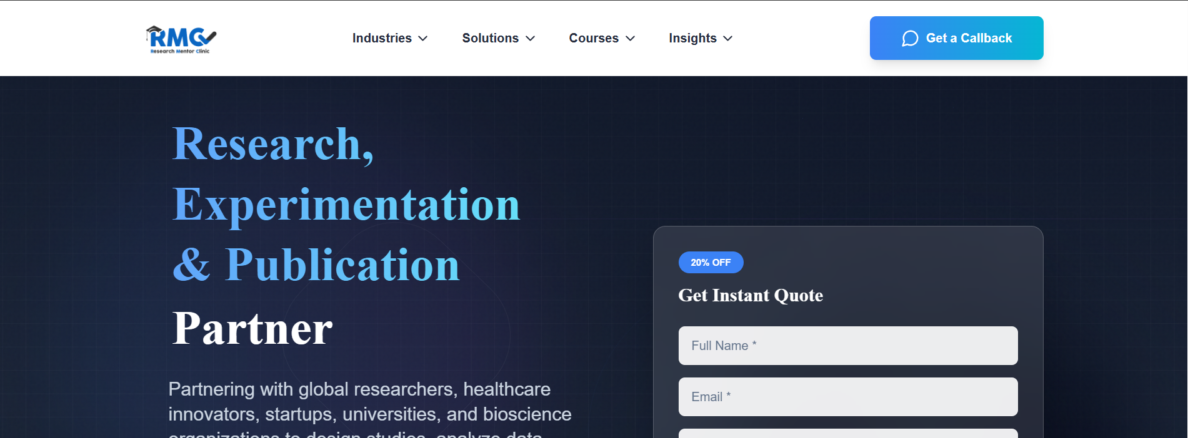
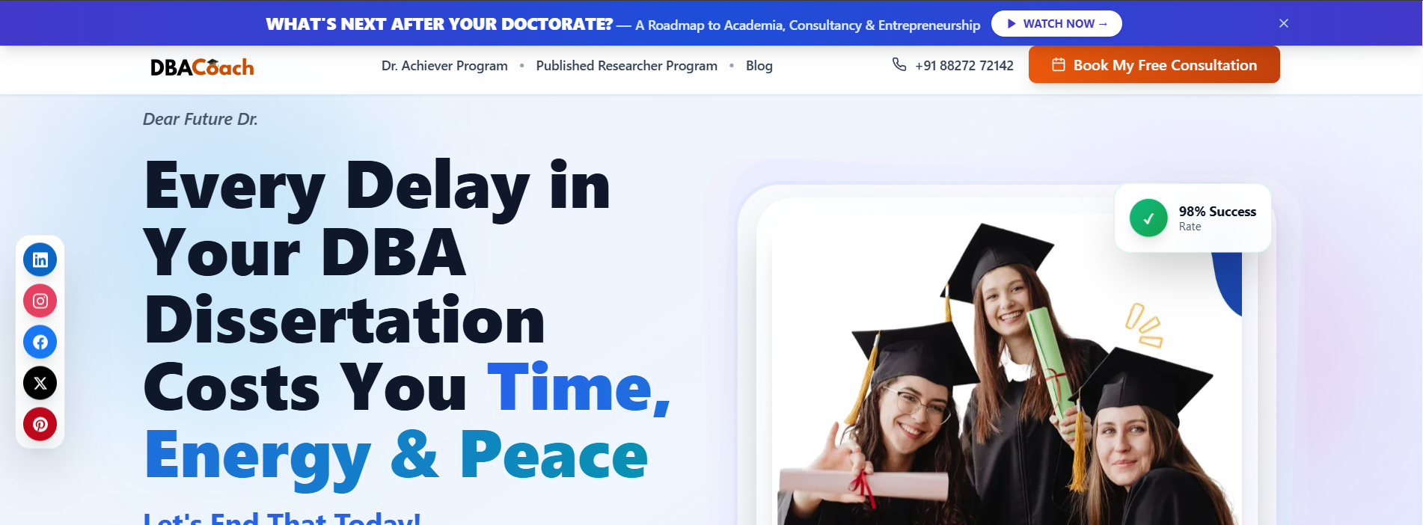

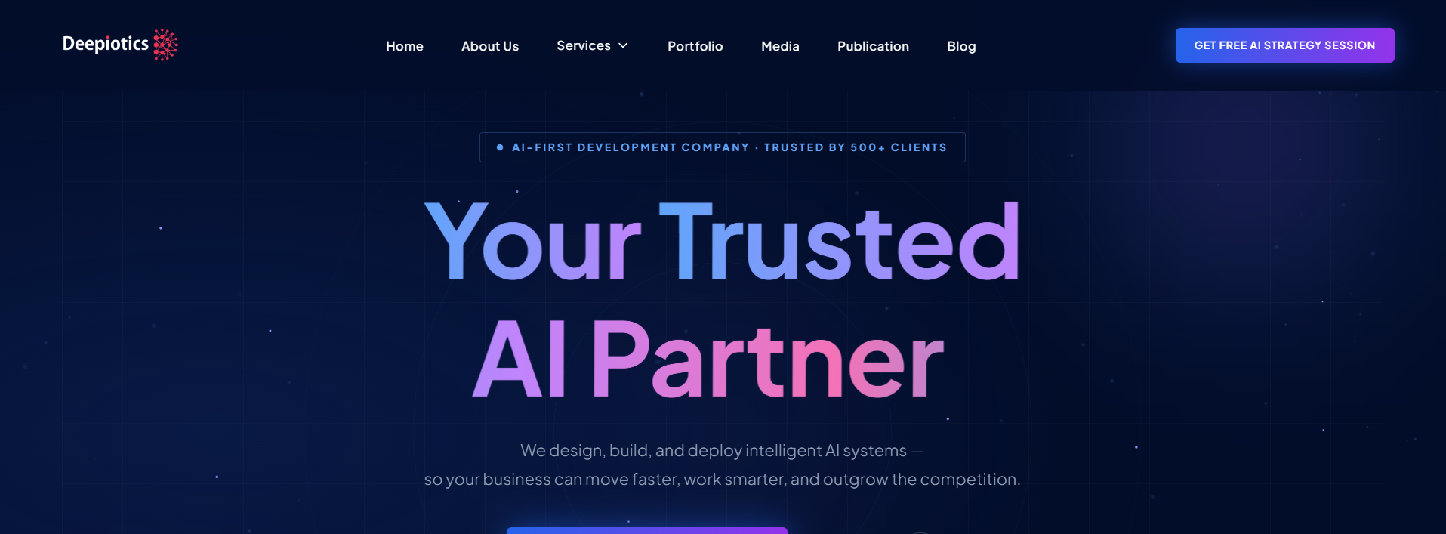
PROOF OF WORK
Recent builds — real clients, real results.
BIOTECH & TRAINING
RESEARCH SERVICES
EXECUTIVE COACHING
BioAI Lab
Research Mentor Clinic
DBA Coach
AI Training · LMS · Consultations
Research · Publication · CRM Leads
Coaching · Consultations · Funnels
ACADEMIC PUBLISHING
OUR OWN PLATFORM
JBPAR Journal
Deepiotics.ai
Peer Review · Submissions · CMS
AI-First Design · Brand · Web App
DEEPIOTICS · WEB SOLUTIONS · 2026
CONFIDENTIAL

Slide 12





THE ENGINE UNDER THE HOOD
World-class technology — explained in plain words.
Your own private server
A rock-solid database
Lightning-fast, worldwide
Hosted on a dedicated Hostinger VPS — real power, not shared with strangers.
Supabase keeps your products, orders, and customers safe and perfectly organised.
Cloudflare delivers your photos and videos in seconds — in every country.
Scales when you go viral
Secure & compliant by design
Handles 100 visitors or 100,000 — we upgrade the server, never rebuild the store.
Encryption, backups, and privacy rules like GDPR — followed from day one.
DEEPIOTICS · WEB SOLUTIONS · 2026
CONFIDENTIAL

Slide 13
HOW WE COMPARE
Custom-built vs. off-the-shelf — see the difference.
WHAT MATTERS
SHOPIFY
WOOCOMMERCE
DEEPIOTICS
Ownership
Platform hosts and controls your store
You own the code, but manage it yourself
You own everything — store, code & content
Design
Built from templates — many stores look alike
Free themes, need heavy customization
Built around your brand — one of a kind
Transaction Fees
Extra fees apply unless using their payment gateway
Depends on the payment gateway you connect
No commissions — 100% of every sale is yours
Hosting & Security
Managed by the platform, limited control
You handle hosting, backups & security patches
Dedicated server, monitored for speed & security
Customization
Most features need paid apps
Plugin conflicts common as the store grows
Built-in features — no plugin patchwork
Support
Ticket-based, generic queue
Community forums, no dedicated help
One partner, one point of contact
DEEPIOTICS · WEB SOLUTIONS · 2026
CONFIDENTIAL

Slide 14
TIMELINE
Live in six weeks — selling from day one.
WEEK 1–2
WEEK 3–5
WEEK 6
ONGOING
Plan & Design
Build
Launch & Training
Grow
We learn your business and design your store — you approve everything.
Products added, payments connected, everything tested.
Store goes live. We train you — or take over maintenance.
Monitoring, updates, and improvements as sales grow.
DEEPIOTICS · WEB SOLUTIONS · 2026
CONFIDENTIAL

Slide 15


AFTER LAUNCH
Launch day is the beginning — not the end.
Full ownership
Whichever plan you choose, you'll never wonder
“who do I call about my store?” again.
Your store, your products, your accounts — everything belongs to you.
Zero tech headaches
Update it yourself with confidence — or let us handle it all. Easy either way.
Always watched
One partner. One point of contact. Zero guesswork.
Speed, uptime, and sales health monitored continuously.
Security & updates
Backups and safety updates applied before problems ever appear.
DEEPIOTICS · WEB SOLUTIONS · 2026
CONFIDENTIAL

Slide 16


THE TEAM
A full in-house team — no outsourcing, no handovers.
Deepiotics is an AI and web development studio with in-house development, design, and QA — delivering stores and platforms for clients across industries and countries.
Developers
Designers
Hosting & security
Proven track record
Engineers who build fast, modern online stores that scale.
Specialists who turn your brand into a store people love to buy from.
Server, backup, and security expertise for launches that just work.
A multi-client portfolio across industries and international markets.
DEEPIOTICS · WEB SOLUTIONS · 2026
CONFIDENTIAL

Slide 17



NEXT STEPS
Book a free store audit.
We'll review how you sell today and show you exactly where you're losing sales — no obligation, no jargon.
1 · Free audit
2 · Tailored proposal
3 · We build
A 30-minute review of how customers find you, browse, and buy today.
A clear plan and scope — self-managed CMS or yearly maintenance.
From kickoff to a live, selling store in ~6 weeks — you're in the loop at every step.
We only take on a handful of new builds each month — free audits booked first-come, first-served.
GET IN TOUCH hello@deepiotics.com · www.deepiotics.com · Atulya IT Park, Indore, India
DEEPIOTICS · WEB SOLUTIONS · 2026
CONFIDENTIAL

Slide 18
Thank you.
Deepiotics — Your Store, Open to the World.
hello@deepiotics.com · www.deepiotics.com
Ready when you are — reply to this proposal or book your free store audit today.
DEEPIOTICS · WEB SOLUTIONS · 2026
CONFIDENTIAL

